Slide 1



Intermediate deliverable: Extraction, Transformation and Loading (ETL) of data sources
Team name: High-Five

Slide 2
Please describe the data sources of your project
Dataset name | Source (organization /provider) | Link (URL) | Coverage (geographic detail and time) | Key variables (max. 5) | Format (CSV, JSON, XLS, SQL, etc.) | Access method (download, API call, scraping, etc.)
Daangn Community Posts (Neighborhood Life) | Daangn Market | https://www.daangn.com/kr/community/s/ | Geographic: Seoul (based on dong fields) Time: 2024-2026 (Depends on crawl period) | content (post text), regionName / gu (location), createdAt (timestamp), subject (category) | CSV | Web Scraping Using Reverse-engineered Internal API Endpoints
Seoul Resident (Domestic) Floating Population by Administrative Dong | Seoul Open Data Plaza | https://data.seoul.go.kr/dataList/OA-14991/S/1/datasetView.do | Geographic: Seoul Time: 2023, 2024 | Total Floating Population | CSV | Public Open Data Download

Slide 3
Please describe the data sources of your project
Dataset name | Source (organization /provider) | Link (URL) | Coverage (geographic detail and time) | Key variables (max. 5) | Format (CSV, JSON, XLS, SQL, etc.) | Access method (download, API call, scraping, etc.)
Cellular Base Station Data | Spectrum Resource Mgmt System | https://spectrummap.kr/gis/mobile_service.do?menuNo=300480 | Geographic: Seoul Time: 2023, 2024 | station_density_4g, station_density_5g | CSV | Public Open Data Download
NIA 5G Connection Quality | Korean Public Data Portal | https://www.data.go.kr/data/15120591/fileData.do | Geographic: Seoul Time: 2023, 2024 | download_speed | CSV | Public Open Data Download
Public Free Wi-Fi Installation Data | Local Admin WiFi License Data | https://www.localdata.go.kr/lif/lifeCtacDataView.do | Geographic: Seoul Time: 2023, 2024 | wifi_density | XSLX | Public Open Data Download

Slide 4
Please describe the data sources of your project
Dataset name | Source (organization /provider) | Link (URL) | Coverage (geographic detail and time) | Key variables (max. 5) | Format (CSV, JSON, XLS, SQL, etc.) | Access method (download, API call, scraping, etc.)
Telecommunication Indicators | SKT Telecom Data | https://www.data.go.kr/data/15127168/fileData.do# | Geographic: Seoul Time: 2023, 2024 | mobile_data_usage, online_service_days, delinq_rate (reverse) | XLSX | Public Open Data Download
Average Monthly Household Income by District | Seoul Commercial Analysis Service | https://data.seoul.go.kr/dataList/OA-22167/S/1/datasetView.do | Geographic: Seoul Time: 2023, 2024 | avg_income | CSV | Public Open Data Download

Slide 5
Please describe the data sources of your project
Dataset name | Source (organization /provider) | Link (URL) | Coverage (geographic detail and time) | Key variables (max. 5) | Format (CSV, JSON, XLS, SQL, etc.) | Access method (download, API call, scraping, etc.)
Seoul Digital Competency Survey | Seoul AI Foundation | https://saif.or.kr/dataroom/2564 | Geographic: Seoul Time: Oct-Dec 2021 (1st wave), Nov-Dec 2023 (2nd wave) | digital device/service usage, digital literacy score, digital safety/security, demographic info, administrative district, etc. | CSV | data provision upon official request

Slide 6
In the next slides, please describe your data processing (ETL) system:
Describe the data cleaning methods
How are you handling missing (non-existent) data?
Where are you storing the data?
Provide a diagram describing the ETL process
NOTE: You will be asked for the final deliverable to submit the code to access, process and store the data

Slide 7
Data cleaning methods
Analysis 1: UMC Index
[Quality]
Input
Cellular Base Station Data: 4G/5G base station coordinates
NIA 5G Connection Quality: connection speed data
Seoul GIS shapefile
Preprocessing
Physical Deduplication: To accurately count coverage points, merged antennas at identical coordinates into a single physical tower point
Spatial Mapping: To aggregate data by district, performed a spatial join.
Output: district-level base station density and download speeds

Slide 8
Data cleaning methods
Analysis 1: UMC Index
[Availability]
Input
Public Free Wi-Fi Installation Data: public wi-fi distribution
Preprocessing
Numeric Coercion: To ensure computational consistency, forced non-numeric strings into float types and imputed missing traffic values with 0.
Population Weighting: To reflect actual digital demand, calculated usage means weighted by the hourly daytime living population.
Output: district-level digital usage and accessibility metrics

Slide 9
Data cleaning methods
Analysis 1: UMC Index
[Affordability]
Input
Telecommunication Indicators: telecom delinquency rates
Average Monthly Household Income by District: district-level income
Preprocessing
Reverse Normalization: To align with other positive indices, applied reverse Min-Max scaling to delinquency rates so higher schores indicate lower financial barriers.
Output: district-level integrated economic accessibility scores

Slide 10
Data cleaning methods
Analysis 1: UMC Index
[Devices / Digital Skills / Safety and Security]
Input
Seoul Digital Competecny Survey
Preprocessing
Invalid Response Filtering: To prevent skewed results, excluded invalid survey codes.
Weighted Aggregation: To ensure statistical representativeness, calculated district averages using survey design weights.
Score Scaling: To enable cross-indicator comparison, normalized raw scores by their respective maximum values.
Output: district-level scores for devices ownership, literacy, and security behavior

Slide 11
Data cleaning methods
Analysis 2
1. Multi-source data integration
Combined Seoul Survey 2023/2024 (Level 1) with UMC Level 2 variables
Merged datasets using district code and survey year
2. Variable harmonization
Standardized variable names across years (e.g., disability, birth year)
Resolved inconsistencies in survey structure (e.g., housing type)
3. Feature engineering
Constructed digital use score from 8 survey items (scaled and aggregated)
Generated binary outcome variables for robustness checks
Recoded socio-demographic variables (education, occupation, income)
4. Normalization and scaling
Applied Min–Max normalization to Level 2 variables (pooled sample)
Adjusted directionality for specific indicators (e.g., delinquency rate)
5. Centering
Performed grand-mean centering for age and income
6. Multicollinearity diagnostics
Checked variance inflation factors (VIF) for independent variables

Slide 12
Data cleaning methods
Analysis 3: Daangn Community Posts
Text Sanitization
To ensure analytical consistency, replaced control characters (\n, \t, \r) with spaces.
Content Truncation
To optimize LLM processing efficiency, limited the text length to 500 characters.
Regional Data Enrichment
To enable geographic analysis, mapped raw `regionId` to administrative district names.
Schema Flattening
To standardize the data for CSV storage, restructured nested JSON attributes into a flat columnar format.

Slide 13
Missing data treatment
Analysis 1: UMC Index
[Qualtiy / Availability / Affordability]
Fallback Logic Implementation: To maintain analytical continuity, substituted missing daytime living population data with administrative area metrics.
Cross-Source Integration: To overcome data latency in official statistics, established income baselines from administrative data and augmented them with high-frequency delinquency rates.
[Devices / Digital Skills / Safety and Security]
Skip-NaN Summation: To maximize data utility, calculated sub-index scores based on available valid responses within partially missing records.
Valid Pair Validation: To secure statistical representativeness, included only records where both the indicator score and design weight were concurrently present for district-level averages.

Slide 14
Missing data treatment
Analysis 2
1. Missing value standardization
Converted non-standard missing values (e.g., “#NULL!”, blanks) to NaN
2. Rule-based handling
For non-digital users: missing responses → assigned zero score
For other cases: retained as missing (NaN)
3. Propagation in derived variables
Missing values preserved in derived variables when source data is missing
4. Listwise deletion
Dropped observations with missing dependent variable
Applied complete-case analysis for Level 1 variables
5. Limited imputation
Replaced missing income values with zero (conservative assumption)

Slide 15
Missing data treatment
Analysis 3: Daangn Community Posts
Invalid Resource Filtering
To minimize data noise, automatically excluded non-existent or deleted posts (HTTP 404, 410).
Default Value Imputation
To prevent runtime errors and maintain integrity, assigned placeholders (0 for counts, “” for strings).
Proactive Rate Limiting
To ensure data completeness, handled 429 errors using an adaptive retry mechanism.

Slide 16
Data storage
<Analysis 1>

Slide 17
Data storage
Analysis 2
1. Storage formats
analysis_df.parquet (efficient for analysis)
analysis_df.csv (for compatibility)
2. Data organization
Raw data stored separately from processed data
External UMC datasets maintained in a dedicated directory
3. Reproducibility
Saved centering parameters and dataset summary statistics
Recorded sample sizes and number of districts
4. Final dataset
Integrated Level 1 (individual) and Level 2 (district) data
Structured for multilevel analysis

Slide 18
Data storage
Analysis 3

Slide 19
ETL diagram
Analysis 1

Slide 20
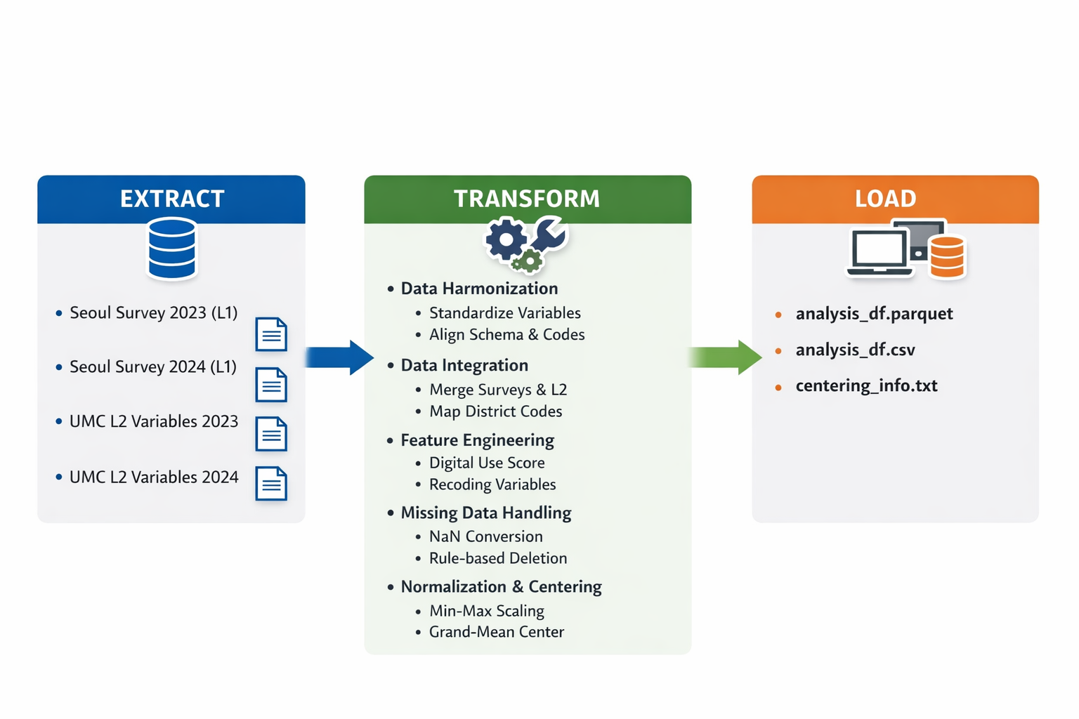
ETL diagram
Analysis 2

Slide 21
ETL diagram
Analysis 3
public data
source: open data portal
type: csv files
community data
source: danng community (async web scrapping)
type: csv files

